Slide 1

OpenStack
Open Source Cloud Software

Slide 2
OpenStack: The Mission
"To produce the ubiquitous Open Source cloud computing platform that will meet the needs of public and private cloud providers regardless of size, by being simple to implement and massively scalable."

Slide 3

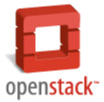
OpenStack Founding Principles
Apache 2.0 license (OSI), open development process
Open design process, 2x year public Design Summits
Publicly available open source code repository
Open community processes documented and transparent
Commitment to drive and adopt open standards
Modular design for deployment flexibility via APIs

Slide 4






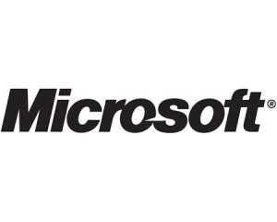
































Community with Broad Commercial Support

Slide 5
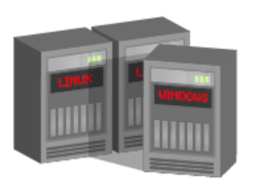
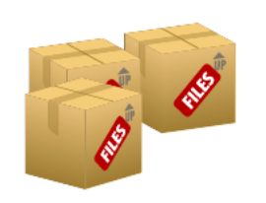
Software to provision virtual machines on standard hardware at massive scale
OpenStack Compute
creating open source software to build public and private clouds
Software to reliably store billions of objects distributed across standard hardware
OpenStack
Object Storage

Slide 6







OpenStack Release Schedule
Diablo:
September 22
Cactus:
April 15, 2011
Followed by conference and design summit in Boston in early October
Bexar:
February 3, 2011
OpenStack Compute ready for large service provider scale deployments
This is the ‘Rackspace-ready’ release; need to communicate Rackspace support and plans for deployment
OpenStack Compute ready for enterprise private cloud deployments and mid-size service provider deployments
Enhanced documentation
Easier to install and deploy

Slide 7
OpenStack Cloud Architecture
Compute

Slide 8
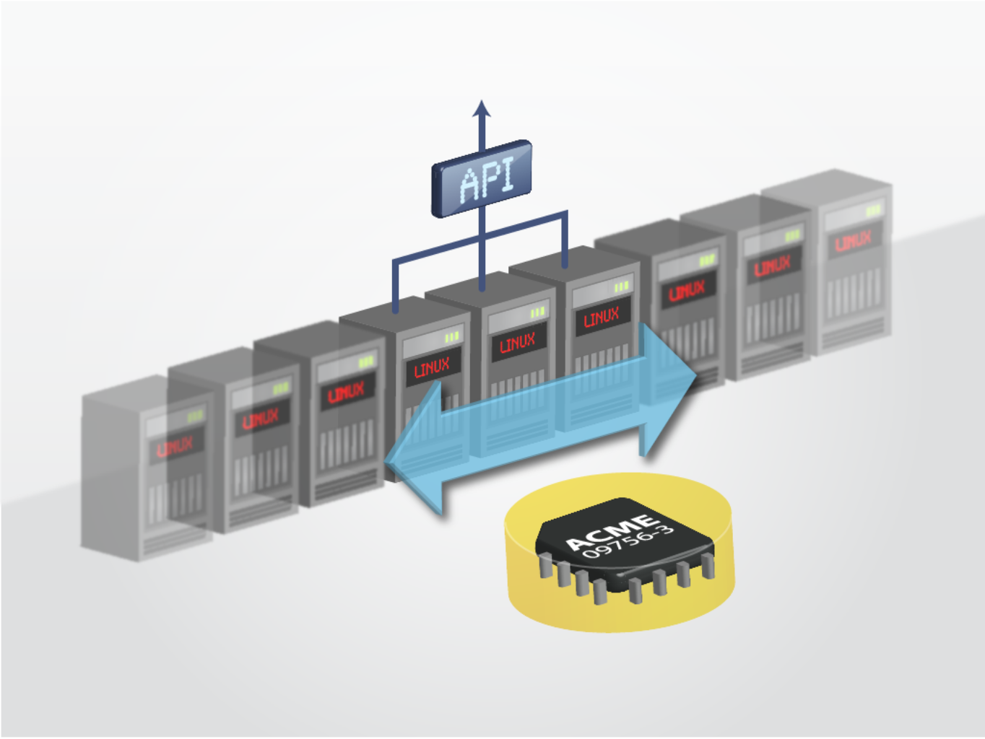
OpenStack Compute Key Features
ReST-based API
Asynchronous eventually consistent communication
Horizontally and massively scalable
Hypervisor agnostic: support for Xen ,XenServer, Hyper-V, KVM, UML and ESX is coming
Hardware agnostic:
standard hardware, RAID not required

Slide 9
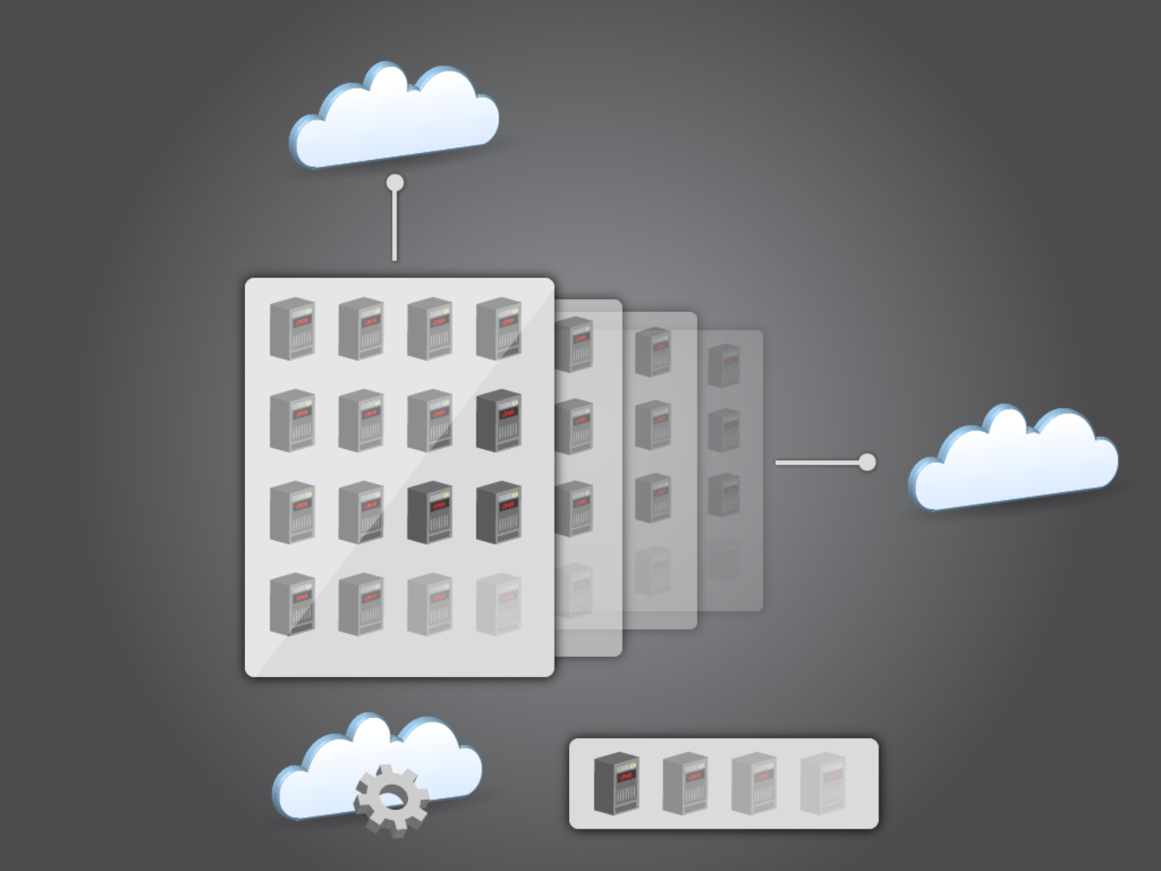
Example OpenStack Compute Hardware (other models possible)
Public Network
Server Groups
Dual Quad Core
RAID 10 Drives
1 GigE Public
1 GigE Private
1 GigE Management
Private Network
(intra data center)
Management

Slide 10
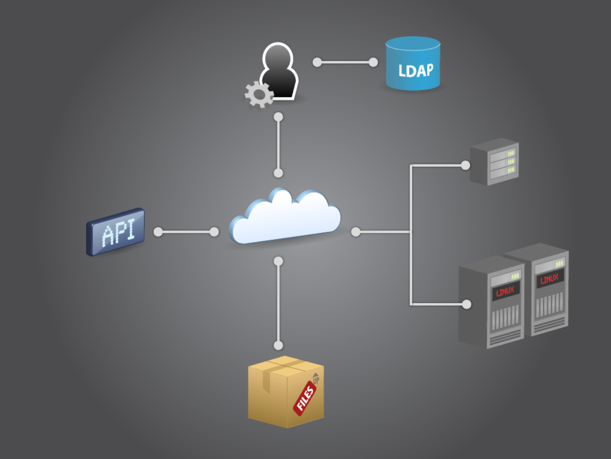
User Manager
Cloud Controllers: Global state of system, talks to LDAP, OpenStack Object Storage, and compute/storage/network workers through a queue
ATAoE / iSCSI
API: Receives HTTP requests, converts commands to/from API format, and sends requests to cloud controller
Host Machines: workers that spawn instances
OpenStack Compute
Glance: HTTP + OpenStack Object Storage for server images

Slide 11
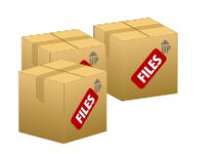
System Components
API Server: Interface module for command and control requests
Designed to be modular to support multiple APIs
In current release: OpenStack API, EC2 Compatibility Module
Approved blueprint: Open Cloud Computing Interface (OCCI)
Message Queue: Broker to handle interactions between services
Currently based on RabbitMQ
Metadata Storage: ORM Layer using SQLAlchemy for datastore abstraction
In current release: MySQL
In Diablo: PostgreSQL
User Manager: Directory service to store user identities
In current release: OpenLDAP, FakeLDAP (with Redis), Database
Scheduler: Determines the placement of a new resource requested via the API
Modular architecture to allow for optimization
Base schedulers included in Bexar: Round-robin, Least busy

Slide 12
System Components (Cont.)
Compute Worker: Manage compute hosts through commands received on the Message Queue via the API﻿
Base features: Run, Terminate, Reboot, Attach/Detach Volume, Get Console Output
Network Controller: Manage networking resources on compute hosts through commands received on the Message Queue via the API
Support for multiple network models
Fixed (Static) IP addresses, VLAN with NAT, DHCP
Volume Worker: Interact with iSCSI Targets to manage volumes﻿
Base features: Create, Delete, Establish
Image Store: Manage and deploy VM images to host machines

Slide 13
New Features in Diablo and Beyond
Quantum: Networking as a Service
Developed in the open by Cisco, Nicira, others
Burrow: HTTP-based message queue
Red Dwarf: Database as a Service
Keystone: Integrated, pluggable auth for all OpenStack components
Lunr: Volumes as a Service
Dashboard: Control nova and other OpenStack components via web

Slide 14
Q & A

Slide 15
OpenStack Cloud Architecture
Object Storage

Slide 16
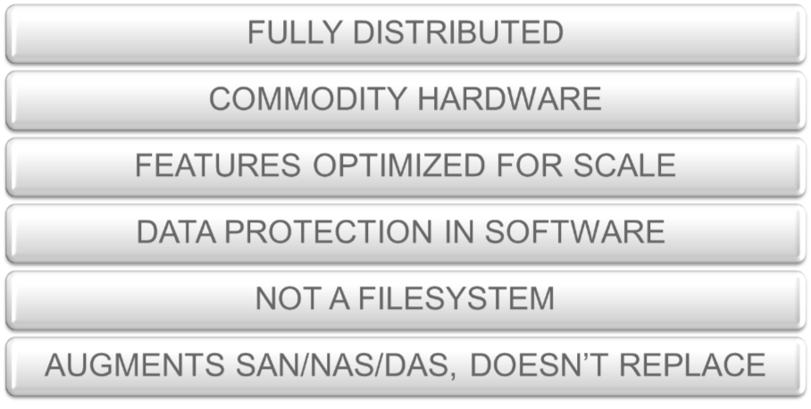
Object Storage Summary
Notes:
16
Distributed, REST-based API, No central database
Hardware agnostic - commodity hardware, RAID not required
Account/Container/Object structure (not file system, no nesting)
Replication (N copies of accounts, containers, objects)
Data distributed evenly throughout system
Scalable to multiple petabytes, billions of objects

Slide 17
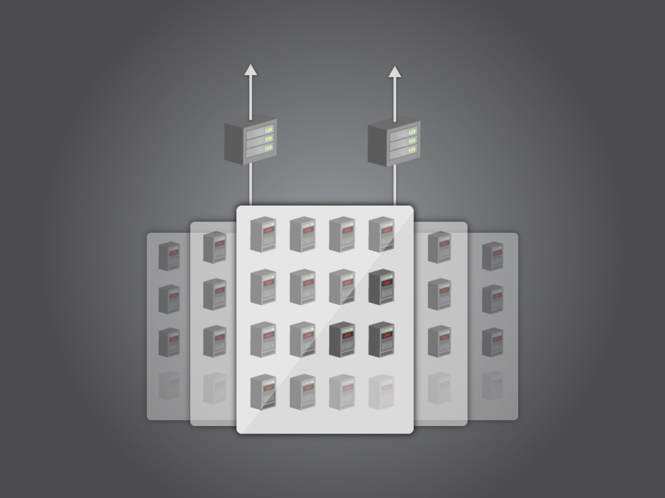
To Load Balancers
Example OpenStack Object Storage Hardware
Proxies
5 Zones
2 Proxies per 25
Storage Nodes
10 GigE to Proxies
1 GigE to
Storage Nodes
24 x 2TB Drives
per Storage Node
Example Large Scale Deployment -- Many Configs Possible

Slide 18
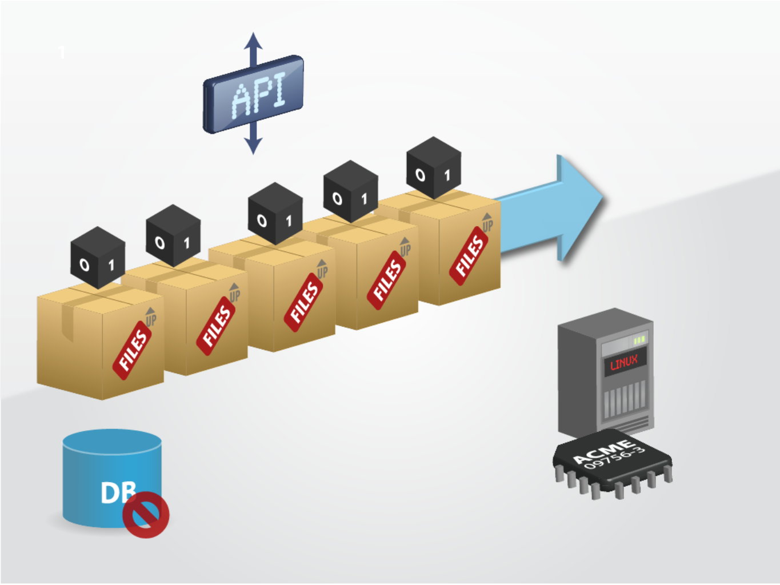
Object Storage Key Features
ReST-based API
Data distributed evenly throughout system
Scalable to multiple petabytes, billions of objects
Account/Container/Object structure (not file system, no nesting) plus Replication (N copies of accounts, containers, objects)
No central
database
Hardware agnostic: standard hardware, RAID not required

Slide 19
System Components
The Ring: Mapping of names to entities (accounts, containers, objects) on disk.
Stores data based on zones, devices, partitions, and replicas
Weights can be used to balance the distribution of partitions
Used by the Proxy Server for many background processes
Proxy Server: Request routing, exposes the public API
Replication: Keep the system consistent, handle failures
Updaters: Process failed or queued updates
Auditors: Verify integrity of objects, containers, and accounts

Slide 20
System Components (Cont.)
Account Server: Handles listing of containers, stores as SQLite DB
Container Server: Handles listing of objects, stores as SQLite DB
Object Server: Blob storage server, metadata kept in xattrs, data in binary format
Recommended to run on XFS
Object location based on hash of name & timestamp

Slide 21
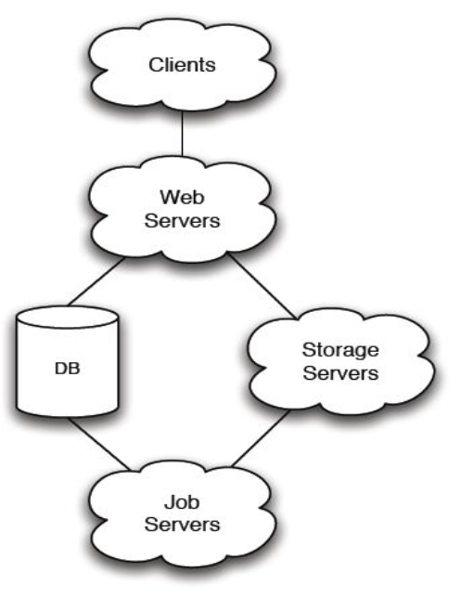
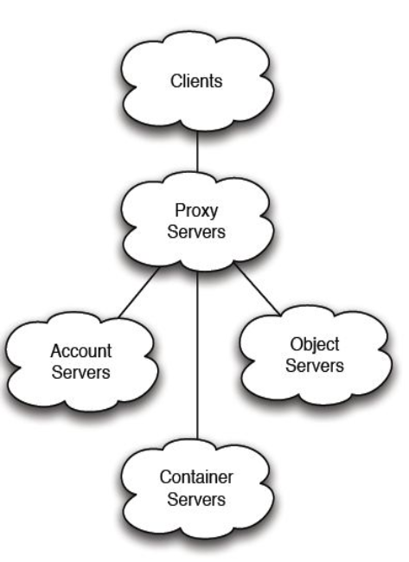

Evolution of Object Storage Architecture
Version 1: Central DB (Rackspace Cloud Files 2008)
Version 2: Fully Distributed (OpenStack Object Storage 2010)

Slide 22
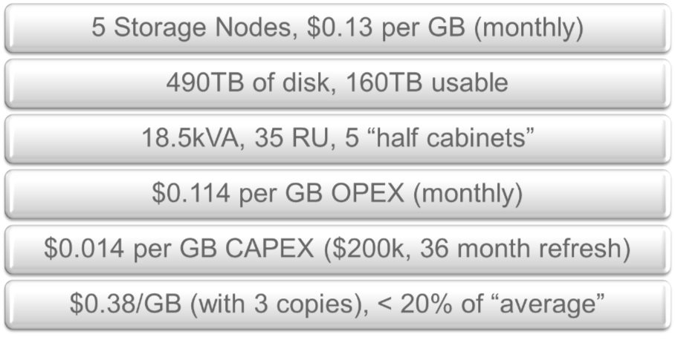
Example Small Scale Deployment
Notes:
22
$0.61/kWh, $499 per “half cabinet” – 1 server per cabinet // CAPEX is servers with DAS and switches from a tier 1 hardware vendor at list price // Electricity is the majority of the cost

Slide 23
Q & A

Slide 24
OpenStack Community
IRC (freenode)
#openstack
#openstack-dev
#openstack-meeting
#lunr
Docs
http://wiki.openstack.org
http://docs.openstack.org
http://swift.openstack.org
http://nova.openstack.org
Twitter
@openstack

Slide 25
Thank You!
Questions & Answers

